Slide 1


Titolo presentazione sottotitolo
Software Engineering 2
Design Document
Milano, XX mese 20XX
Lo Bianco Riccardo, Manzoni Mirco, Mascellaro Giuseppe
A.A. 2016/2017
Professor Di Nitto Elisabetta

Slide 2
Architecture Overview

Slide 3
Clients
PowerEnJoy Mobile App
Web Browser
Car
Special Parking Area
Operator Application

Slide 4
Servers
Proxy Server
Web Server
Application Server
Database Server

Slide 5
Architecture Patterns (1)
Client/Server
Robustness
Reliability
Security
Performance
Scalability (horizontal)
Recovery from disasters
Maintainability
Portability (due to Java EE)

Slide 6
Architecture Patterns (2)
Publisher/Subscriber
Broadcast dispatch of notifications to operators
Notification dispatcher considered as a publisher
Operators subscribed to the publisher through the login

Slide 7
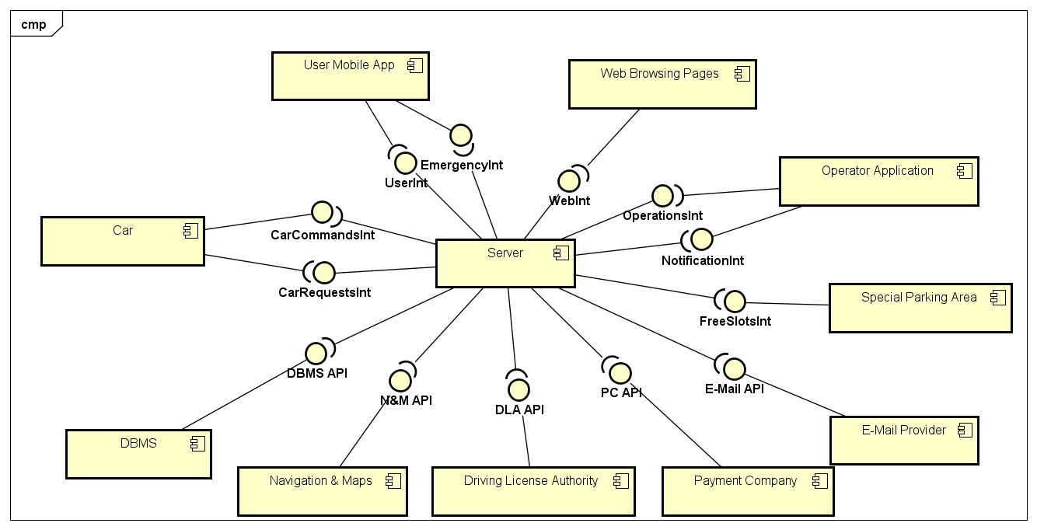
High Level Component View

Slide 8
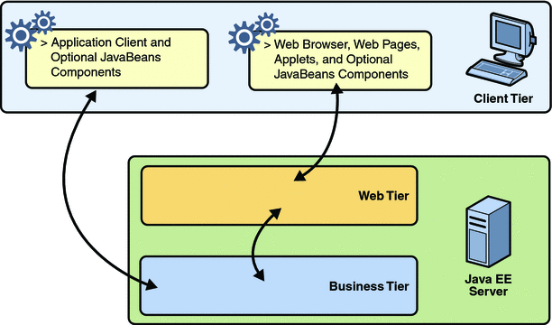
Deployment View

Slide 9
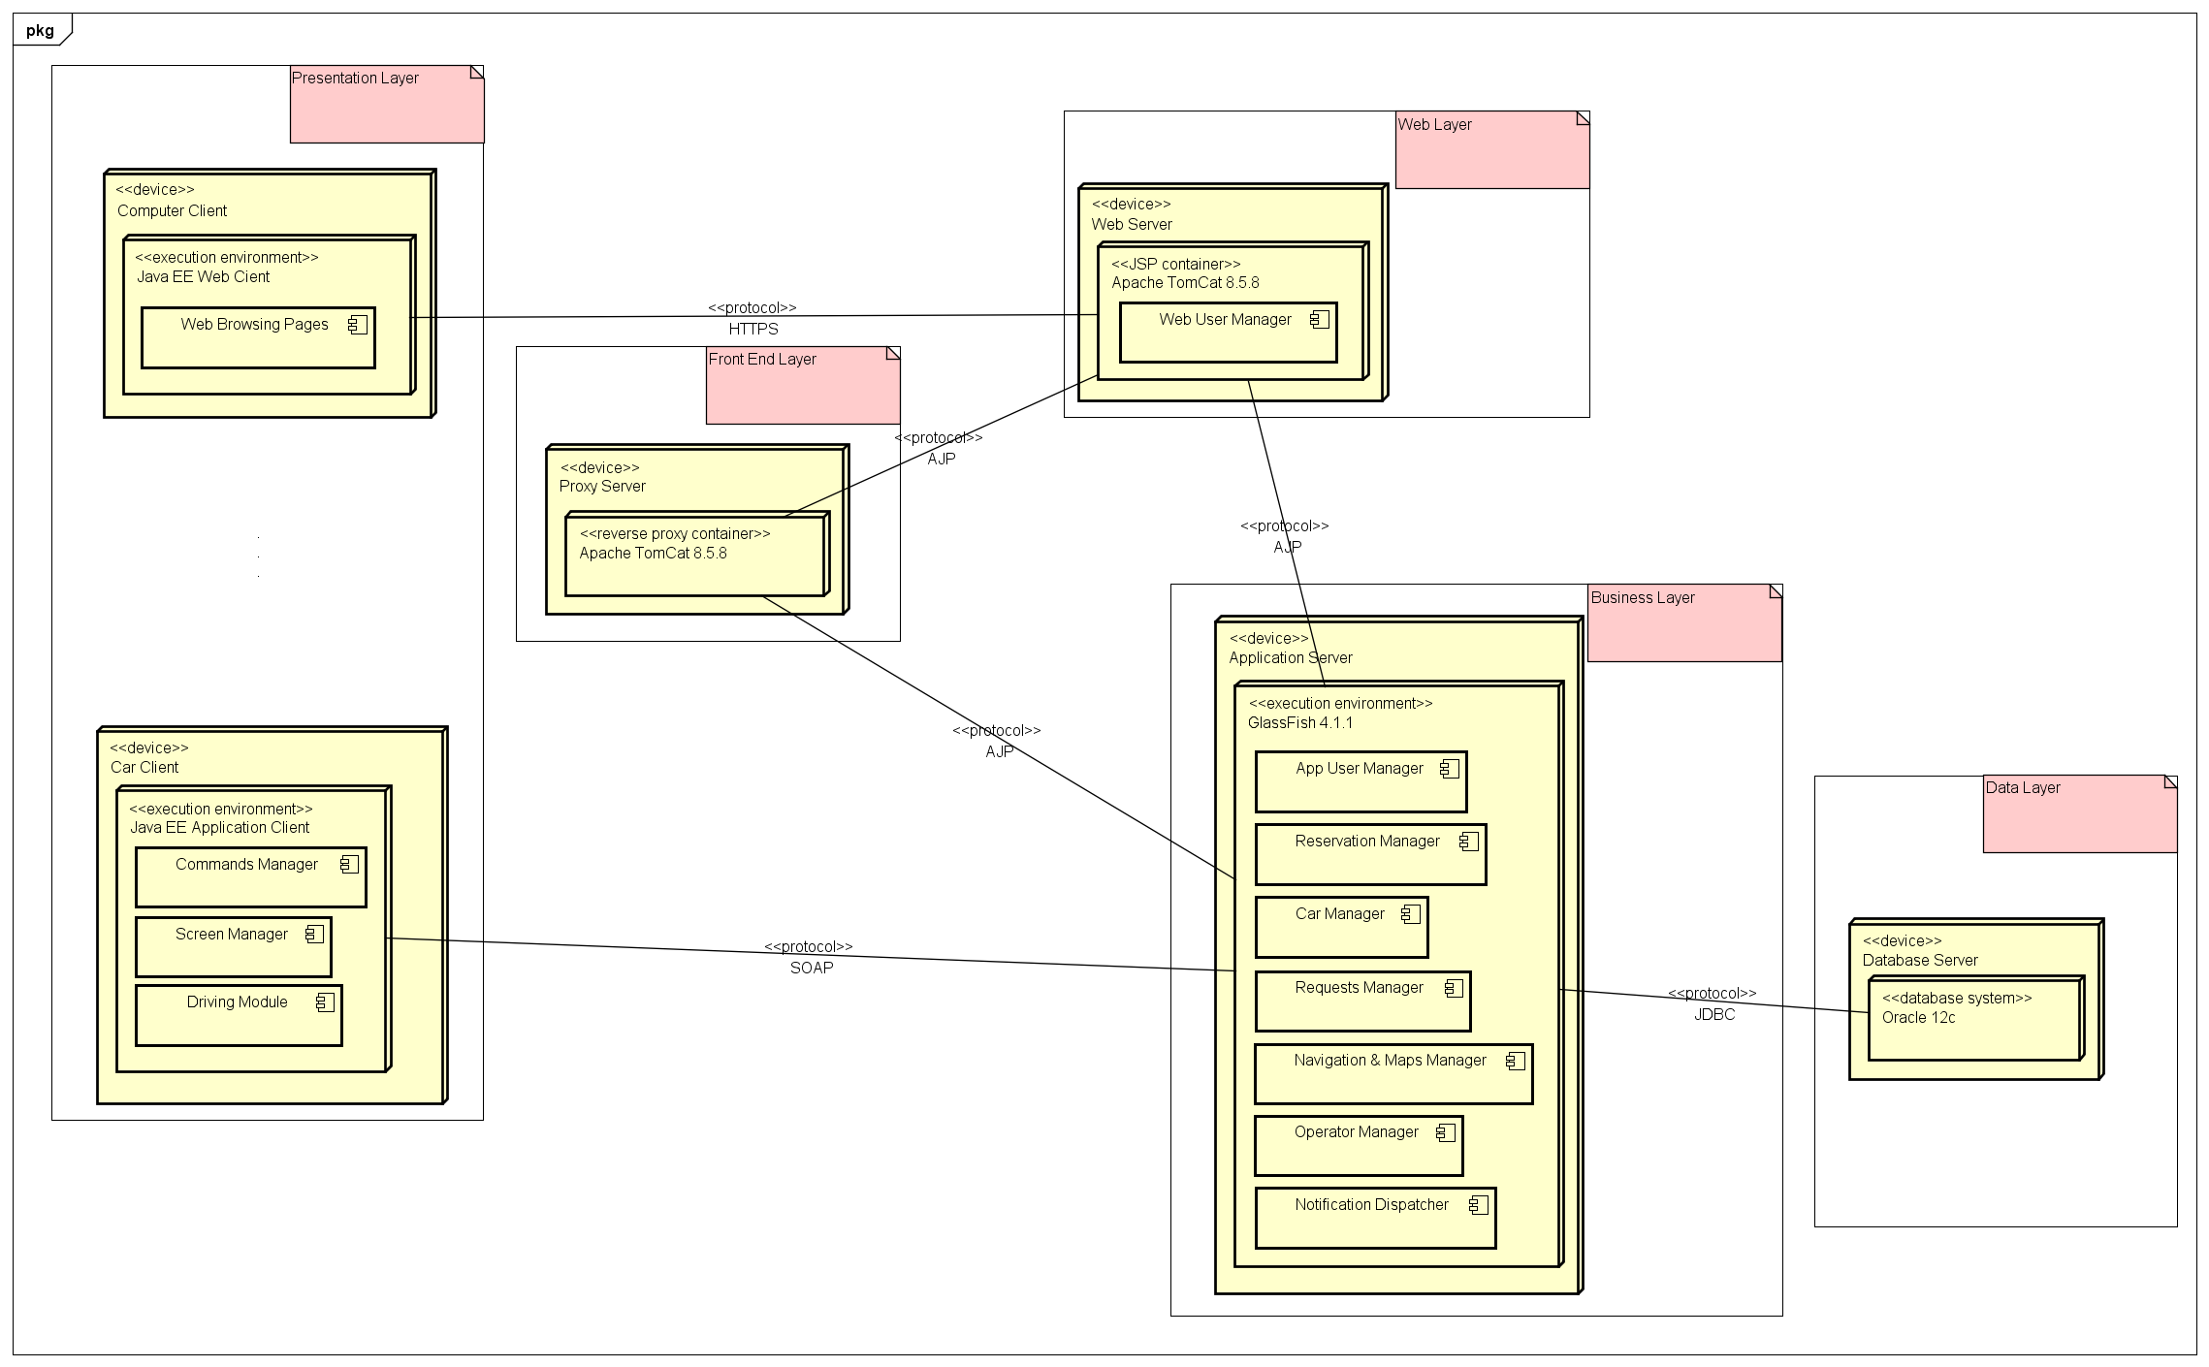
Deployment View – Application end to end
.
.
.

Slide 10
Money Saving Option Algorithm
Produce a list of spa in a range of K meters from the desired destination.
Each zone is marked with a weight that takes into account the current date and the attractiveness of the zone.
Set the spa with the lowest value of (numCars*zoneWeight) amongst those listed at point 1 as the new destination.
If the first iteration of the algorithm produces an empty list, the function is called iteratively with a higher K.
If further iterations do not produce any result, the iteration is stopped as soon as K reaches a fixated threshold, otherwise the path for the chosen spa is shown through the car screen.

Slide 11
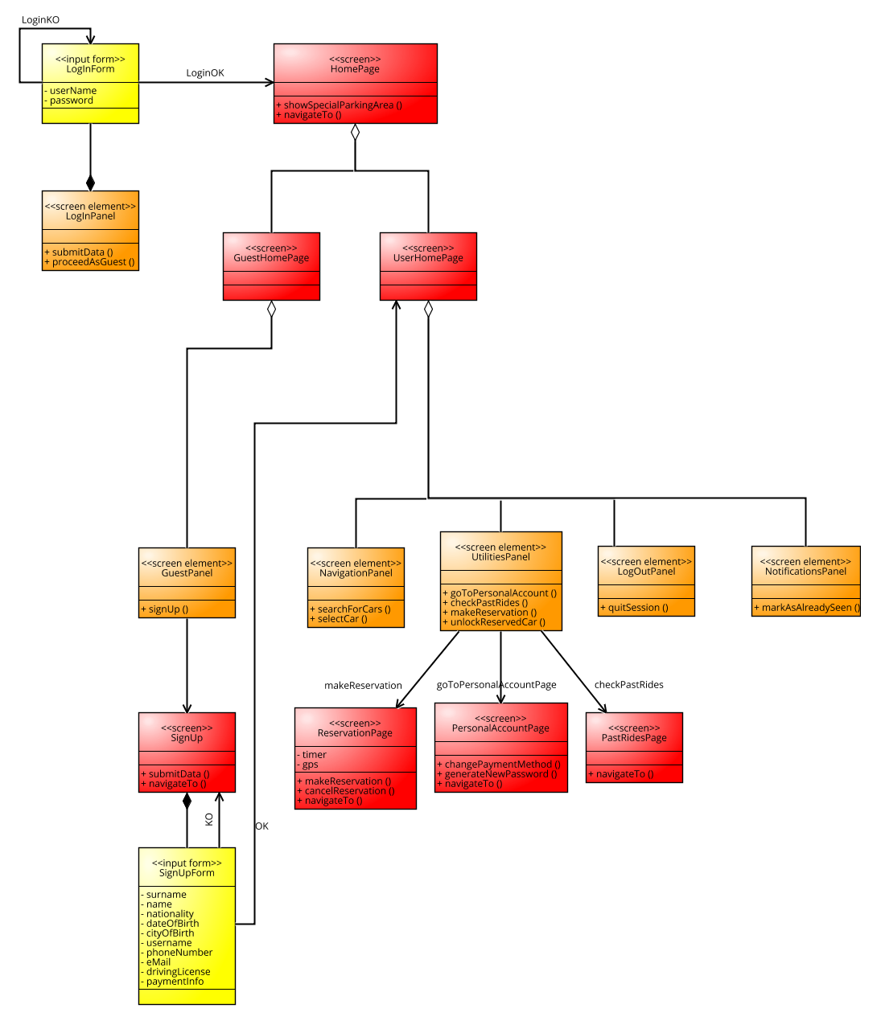
Interface Design: User App

Slide 12
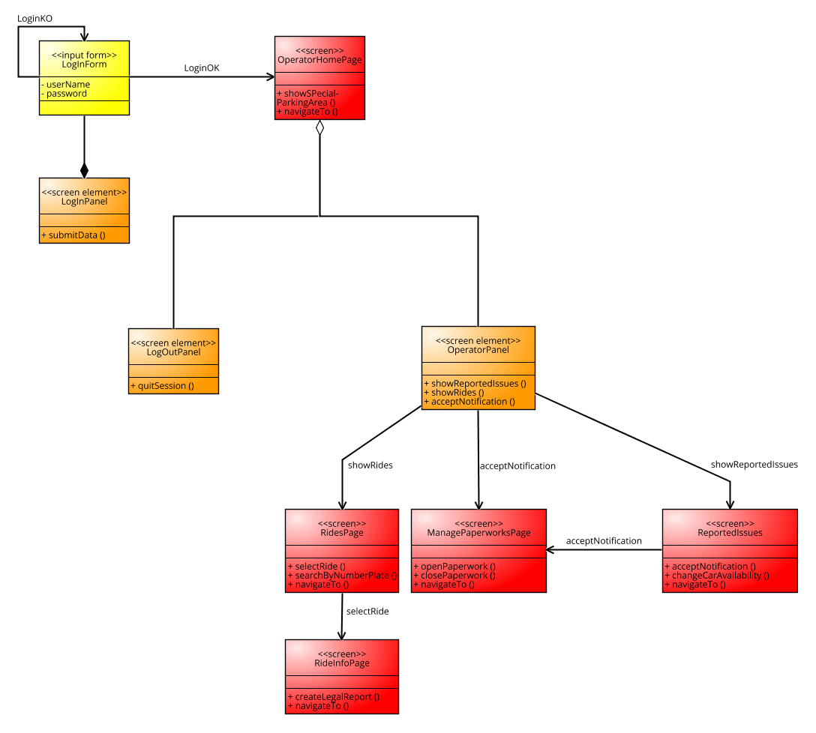
Interface Design: Operator Application

Slide 13
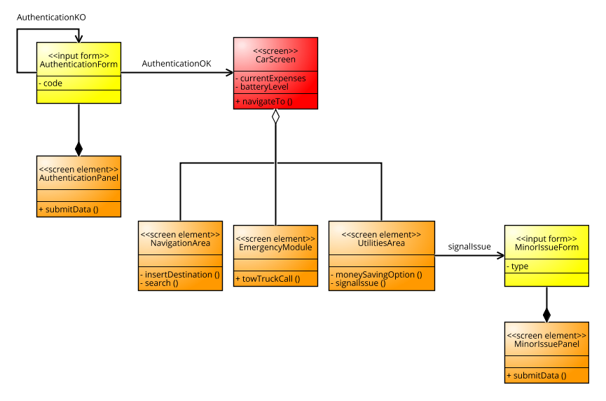
Interface Design: Car Screen

Slide 14
References
DD.pdf: the chapter of the complete documentation regarding architecture
TexWorks (www.tug.org/texworks/): framework for LaTex text format
Signavio (www.signavio.com): online framework for modeling class dia-
grams
Astah Professional 7.1.0 (www.astah.net): tool for modeling component,
deployment sequence diagrams
Draw.io (www.draw.io): online tool for modeling ER diagrams

Slide 15
A thanks to all of you

